Slide 1
Teaching Schoolchildren Pedestrian Safety: A Pragmatic Trial Using Virtual Reality
David C. Schwebel¹, Daniel Rodriguez², Virginia Sisiopiku¹, Joan Severson³, & Tabitha Combs²
¹ University of Alabama at Birmingham
² University of North Carolina, Chapel Hill
³ Digital Artefacts, LLC

Slide 2
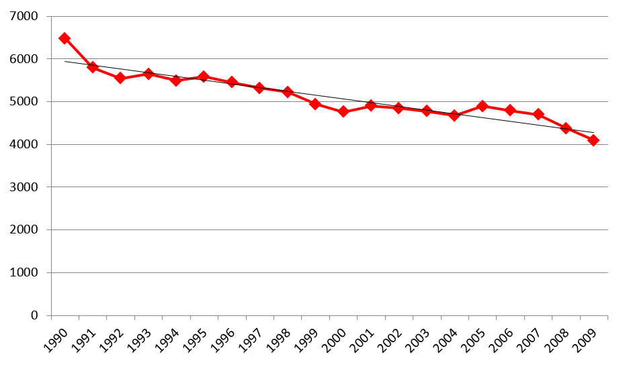
Epidemiology of Pedestrian Injuries
Despite improvements, annually:
Over 4,100 American pedestrians killed
Over 215,000 American pedestrians seriously injured
About ⅓ of injured pedestrians are children
Southeastern US has increased risk, perhaps due to climate, culture, and traffic patterns
Pedestrian Fatalities
Year

Slide 3
Pedestrian Behavior: A Complex Cognitive, Perceptual, and Motor Task
How do children cross the street?
Crossing at a “basic” street environment
Adding complexity: road environment factors
Parked cars, obstructions, curves, inclines
Route selection
Distracted, drunk, or speeding drivers
In NC, pedestrian “failing to yield” represents 14.7% of all crashes
Adding complexity: child factors
Cognitive immaturity
Impulse control
Distraction
In NC, darting represents 6.6% of all crashes

Slide 4
So, how do we prevent pedestrian injuries? A multifaceted approach
Traffic Environment
Example opportunities: Roadway design, designated pedestrian crossing areas, traffic calming, pedestrian barriers and bridges
Drivers
Example opportunities: Reduce speeding, reduce distracted driving, reduce drunk driving, increase awareness of pedestrians, increase compliance with laws and regulations
Parents and Other Adults
Example opportunities: Supervision, Walking School Buses, Crossing Guards
Children
Our current focus

Slide 5
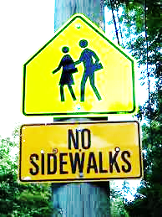
How and when do we teach children?
What age?
2? 5? 7? 10?
What strategy?
Films, games, websites
Classroom teaching
Streetside training
Virtual reality
Efficacy, cost, practicality
Need multidisciplinary team and attention to technology

Slide 6
Virtual Reality
Allows safe engagement in the environment without risk of injury
Permits careful control of traffic but immersion in an environment that feels real and presents no risk of injury
Offers opportunity for repeated practice at the cognitive-perceptual task to be learned
Offers immediate feedback on safety of crossings

Slide 7
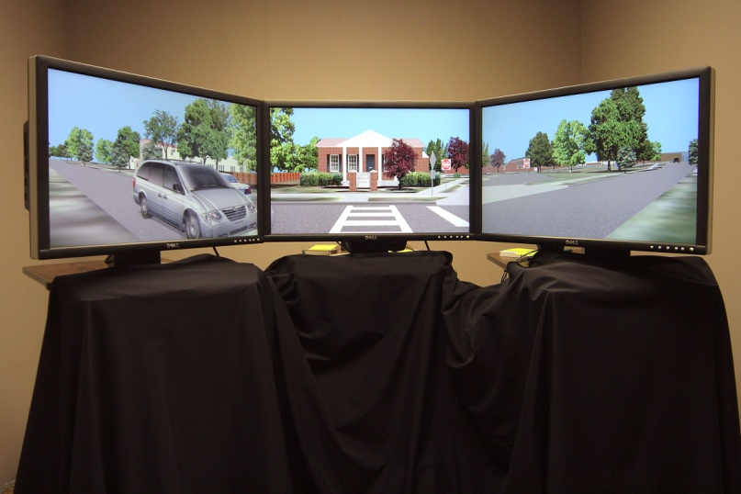
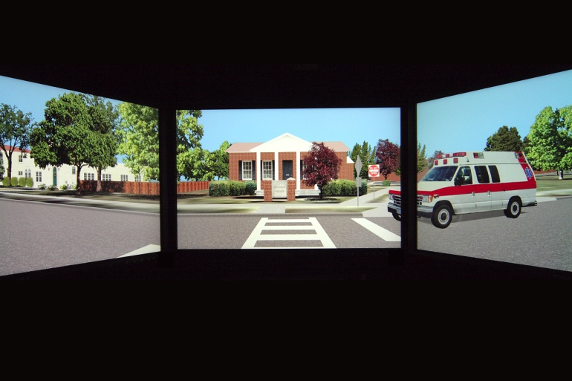
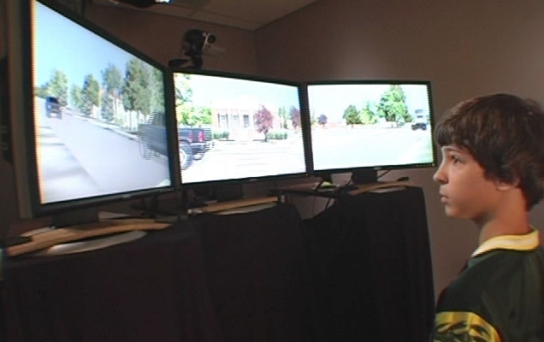
A Pedestrian Virtual Environment Prototype

Slide 8
The Environment: A Video Presentation
PLEASE GO TO THIS LINK:
http://www.psy.uab.edu/schwebel.htm

Slide 9
Background: Randomized Trial
Randomized controlled trial comparing:
No training
Training in the virtual environment
Training street-side with an adult
Training using computer software
240 children ages 7-8 recruited
Behavior measured pre-intervention, post-intervention, and 6-month follow-up

Slide 10
Pedestrian Safety: Assessment Methodology
VR assessment
30 crossings, 10 at each of three “difficulty” levels: 25 MPH traffic and light volume of 8 vehicles/minute; 30 MPH/12 vehicles per minute; 35 MPH/16 vehicles per minute)
Field assessment
Naturalistic setting with actual traffic
“Shout” technique, 8 crossings
“Two-step” technique, 8 crossings

Slide 11
Outcome Measures
Hits/Close Calls – instances when the child would have been struck by a vehicle in the real environment, or when the gap between the participant and an oncoming vehicle was less than one second
Attention to Traffic (not discussed)
Start Delay (not discussed)

Slide 12
Results: Hits/Close Calls
In VR, streetside and VR training groups show similar decrease in hits/close calls
In Field, all groups show increase post-training. VR, video, and control group show some decrease at follow-up
General trend for decreases among VR and streetside training groups
From Schwebel et al, in press, Health Psychology

Slide 13
Summary
VR seems to help children learn to cross streets safely
Individualized streetside training also is effective
Videos and internet programs show minimal evidence of efficacy
PROBLEM: how do we get lots of children into a VR pedestrian environment???

Slide 14
Solution: Community VR
Develop a VR that is light, portable, durable, and easy to use
Install and use in schools, community centers, after-school programs, religious institutions
Currently in development using children’s museum displays as a model

Slide 15
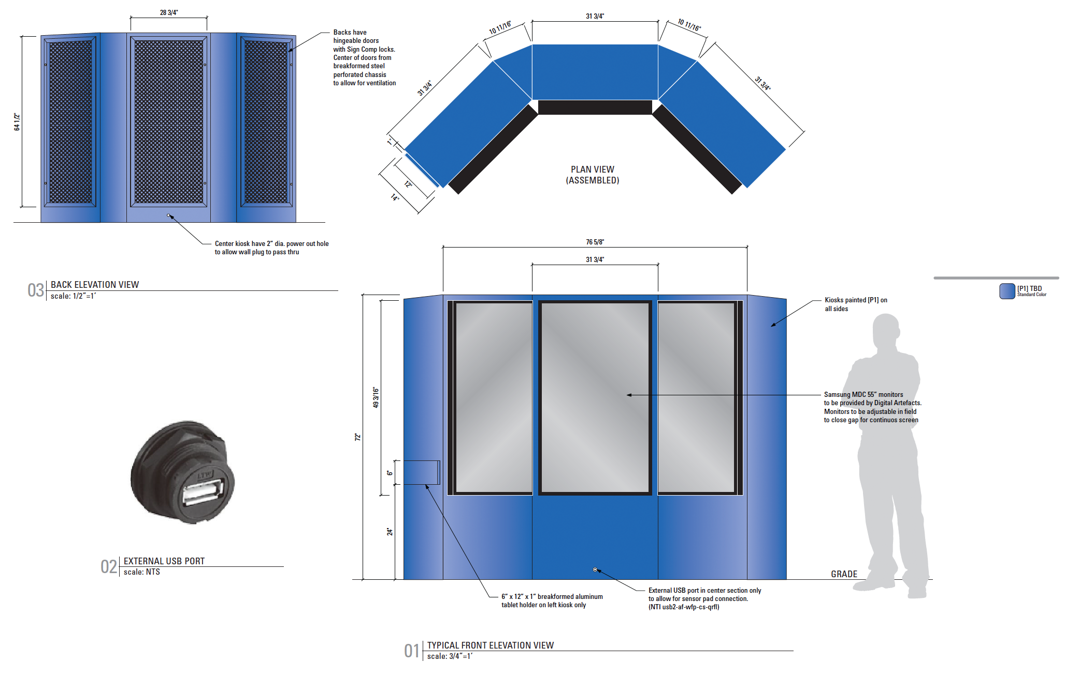

Slide 16
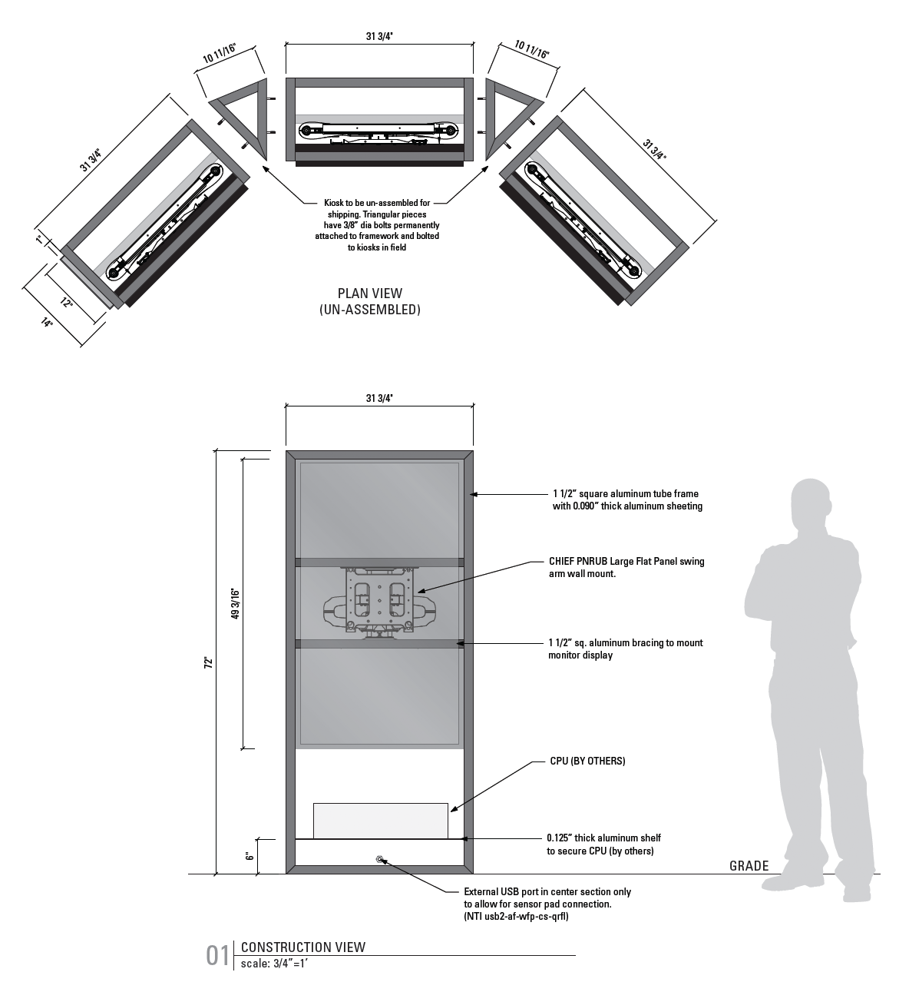

Slide 17
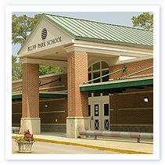
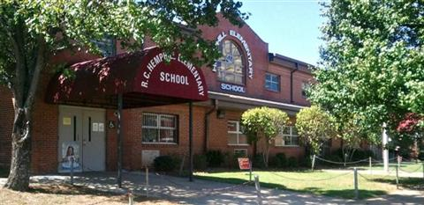
Pragmatic Trial
Conducted in community by community members
Research team involved only for assessments

Slide 18
Research Design
Pre vs. Post research design, evaluating children’s improvement following training
Thorough assessment of pedestrian safety prior to and after training in the VR
Hits/close calls
Start delay (delay entering safe traffic gap)
Attention to traffic (looks left and right while waiting, divided by time)

Slide 19
Project Timeline
Pre-intervention assessments of children from Hemphill Elementary are ongoing
Virtual environment to be installed in Hemphill on March 31 and remain there for 3 weeks
Following installation at Hemphill, Virtual Environment will be moved to Bluff Park Elementary for 3 weeks
Assessment of children will continue in UAB Youth Safety Lab
Data available by Summer 2014, dissemination of results starting in Fall 2014

Slide 20
Acknowledgements
Digital Artefacts team
UAB students and staff: Anna Johnson and Mostafa Emeira
Early research: Leslie McClure, Elizabeth O’Neal, Anna Johnston, Award Number R01HD058573 from the Eunice Kennedy Shriver National Institute of Child Health & Human Development.
Current research: Grant # 2013-004S, Southeastern Transportation Research Innovation, Development and Education (STRIDE) Consortium, University of Florida and US Department of Transportation
Matching funds: UAB College of Arts and Sciences and ALDOT

Slide 21
Discussion and Questions
Contact Information:
David C. Schwebel, Ph.D. Professor of Psychology Associate Dean for Research in the Sciences University of Alabama at Birmingham 1300 University Blvd., HHB 571 Birmingham, AL 35294 USA
Phone: 1 (205) 934-8745 Email: schwebel@uab.edu

Slide 22
FOLLOWING SLIDES
ONLY DURING QUESTIONS

Slide 23
Solution #2: VR over the Internet
Develop a VR that can be delivered via the Internet
Sacrifice some realism and immersion to provide dissemination power
Must provide adequate practice at the cognitive-perceptual task of crossing to yield learning
Currently in development stage. Feasibility demonstrated. See:
http://pedsim.digitalartefacts.com/player/WebPlayer.html

Slide 24
Results: Attention to Traffic
In VR, VR group showed increased attention post-training and others fairly flat. All groups show increase at follow-up, perhaps due to developmental processes
In Field, VR decreases post-intervention and control at follow-up. Other groups fairly flat.
Perhaps children have adequate attention to traffic at this age prior to training??
From Schwebel et al, in press, Health Psychology

Slide 25
Results: Start Delay
In VR, streetside has increase and others decrease. VR shows greatest decrease post-intervention. Streetside shows large decrease at follow-up.
In Field, pattern is similar but muted. Streetside reacts with post-intervention increase but decrease at follow-up. Others show some decrease, especially VR, at post-intervention.
Good proxy for cognitive thinking process. VR training shows some evidence of efficacy, and efficacy similar to individualized streetside training.
From Schwebel et al, in press, Health Psychology

